Slide 1

Discriminatory Order Assignment and Payment-Setting of On-Demand Food-Delivery Platforms: The Impacts of Data Privacy Regulations
Presenter: Zijian Zhao
Department of Civil and Environmental Engineering
The Hong Kong University of Science and Technology

Slide 2



Background: Algorithm Discrimination in Food-Delivery Platforms
Learning algorithm in food-delivery platforms:
profit maximization: Platforms aim to achieve optimal control over couriers while offering the lowest payment.
overuse of privacy data: Platforms utilize personal data to differentiate between various types of couriers.
Discriminatory algorithmic labor management:
personalized payment: Couriers have varying expected salaries for the same work (referred to as ‘reservation value’) → violating principle of ‘equal pay for equal work’
dispatching preference: Couriers with high willingness to work present higher certainty and lower costs for platforms → prioritize couriers with more favorite working pattern
Couriers controlled by algorithms:
Notes:
1. background: black-box RL+profit maximize->discrimination
2. reflection: payment & dispatching
3. infleucen: mental and physical health
4. behind reason: overuse individual information

Slide 3



Background: Data Privacy Regulation (DPR)
Take GDPR (Europe) as an example:
Article 6.1.a : Data processing is lawful only when the data subject has provided consent for one or more specific purposes.
Article 7.2: Individuals have the right to withdraw consent at any time, and the process for withdrawal must be as simple as providing consent.
Basic principles of DPR:
data minimization
user content, individual control over personal information
GDPR
PIPL
CCPA
Notes:
1. data regulation policy requires: platform use minimum necessary data
customers & couriers have the rights to decide whether to allow platform use and collect the individual data
also can change their choice at any time they want
2. mostly current works are based on statistical analysis and interview research on specific example
unsure about how DPR influence the behavior and profit of platforms and couriers

Slide 4
Research Questions
Challenges in identifying the DPR for stakeholders:
The dispatching strategy and payment strategy of platforms are coupled.
Couriers' behaviors occur on different time scales:
long-term: decide whether to work on the platform and whether to share their personal information
short-term: determine whether to accept assigned orders
Complex game process between platform and couriers, as well as among the couriers themselves
Research questions:
Q1: How to model and optimize the behavior and strategy of platforms and couriers?
Q2: How does the discriminatory algorithm influence platforms and couriers?
Q3: How does data privacy regulation policy influence food delivery market?
Notes:
1. payment: continuous, dispatching: discrete; limited RL work considering the joint optimization for continous and discrete action space
2. courier behavior has two time scales
3. the game proces is complex

Slide 5
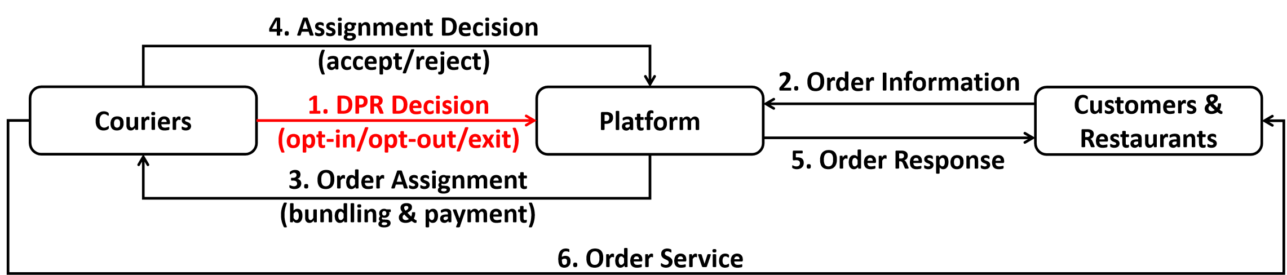
System Workflow
Platform：determine order assignment and payment setting
Couriers：
long-term: choose from opt-in (work with providing personal information), opt-out (work without providing personal information), or exit (do not work) at the beginning of each time period
short-term: determine whether to accept the assigned order based on payment and individual reservation value
Customers & Restaurants:
set orders at arbitrary times
cancel the order if not confirmed within a maximium time threshold

Slide 6
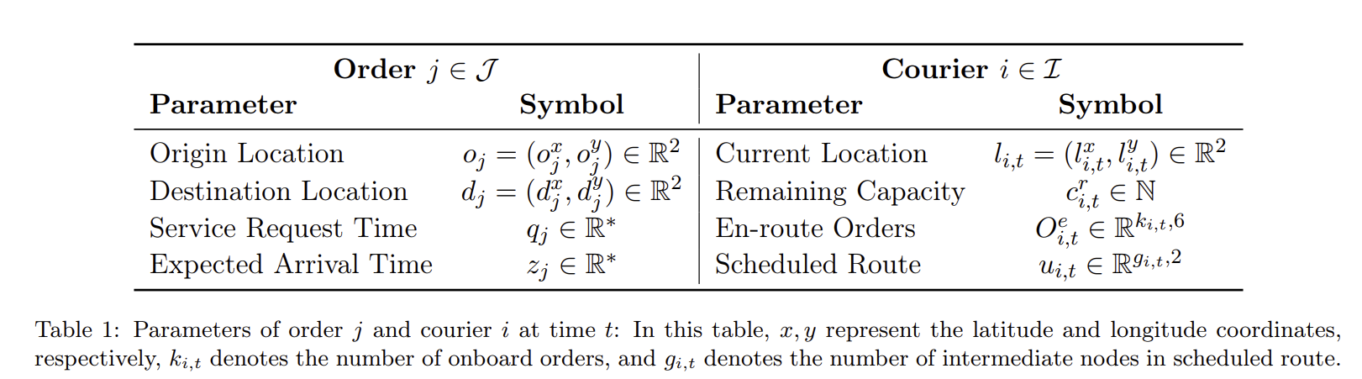
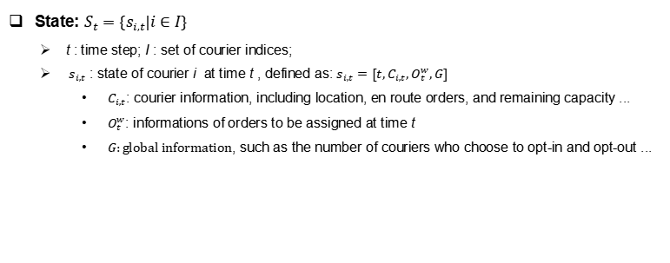
Model for Platform: MDP
State: $S_{t}=\{s_{i,t}|i∈I\}$
t : time step; I : set of courier indices;
$s_{i,t}$ : state of courier i at time t , defined as: $s_{i,t}=[t,C_{i,t},O_{t}^{w},G]$
$C_{i,t}$: courier information, including location, en route orders, and remaining capacity ...
$O_{t}^{w}$: informations of orders to be assigned at time t
$G:global information$, such as the number of couriers who choose to opt-in and opt-out ...

Slide 7
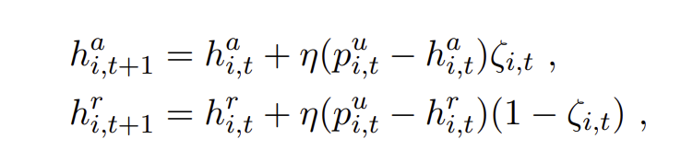
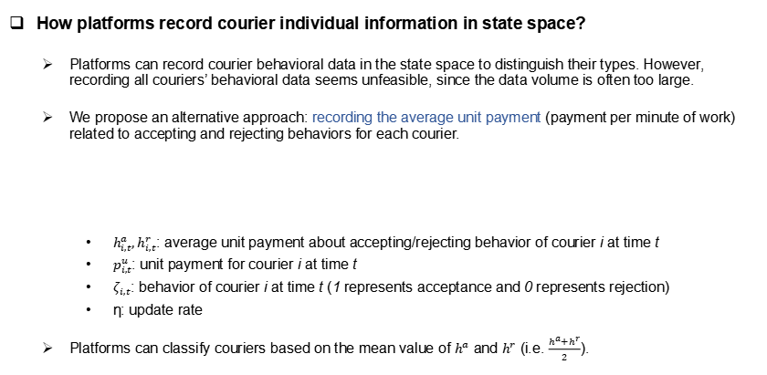
Model for Platform: MDP
How platforms record courier individual information in state space?
Platforms can record courier behavioral data in the state space to distinguish their types. However, recording all couriers’ behavioral data seems unfeasible, since the data volume is often too large.
We propose an alternative approach: recording the average unit payment (payment per minute of work) related to accepting and rejecting behaviors for each courier.
$h_{i,t}^{a},h_{i,t}^{r}$: average unit payment about accepting/rejecting behavior of courier i at time t
$p_{i,t}^{u}$: unit payment for courier i at time t
$ζ_{i,t}$: behavior of courier i at time t (1 represents acceptance and 0 represents rejection)
η: update rate
Platforms can classify couriers based on the mean value of $h^{a}$ and $h^{r}$ (i.e. $\frac{h^{a}+h^{r}}{2}$).
Notes:
Exponential moving average

Slide 8
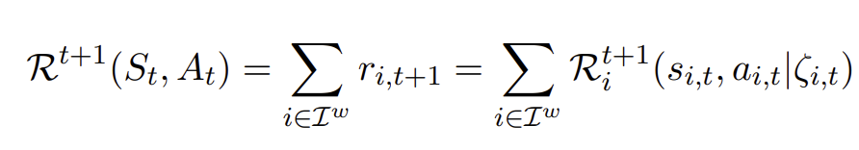
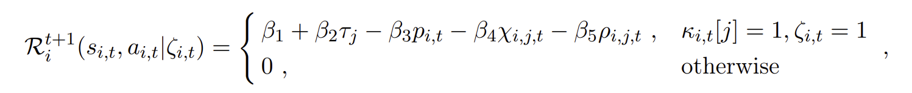
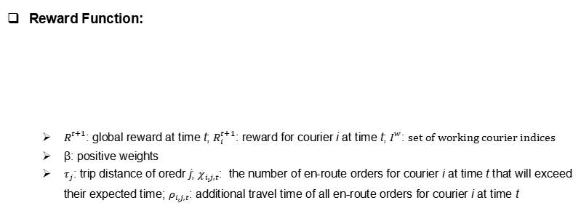
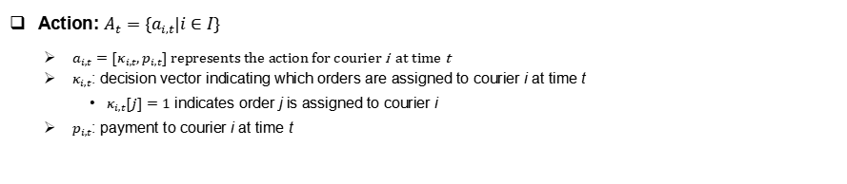
Model for Platform: MDP
Action: $A_{t}=\{a_{i,t}|i∈I\}$
$a_{i,t}=[κ_{i,t},p_{i,t}]$ represents the action for courier i at time t
$κ_{i,t}$: decision vector indicating which orders are assigned to courier i at time t
$κ_{i,t}[j]=1$ indicates order j is assigned to courier i
$p_{i,t}$: payment to courier i at time t
Reward Function:
$R_{ }^{t+1}$: global reward at time t; $R_{i}^{t+1}$: reward for courier i at time t; $I_{ }^{w}$: set of working courier indices
β: positive weights
$τ_{j}$: trip distance of oredr j; $χ_{i,j,t}$: the number of en-route orders for courier i at time t that will exceed their expected time;$ρ_{i,j,t}$: additional travel time of all en-route orders for courier i at time t
Notes:
platform income from customer
platfomr outcome (payment to couriers)
customer satisfaction

Slide 9
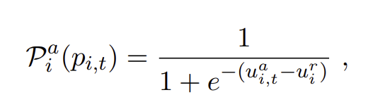
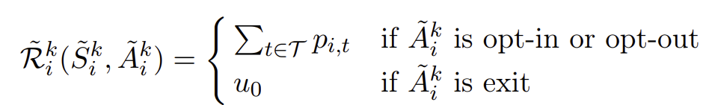
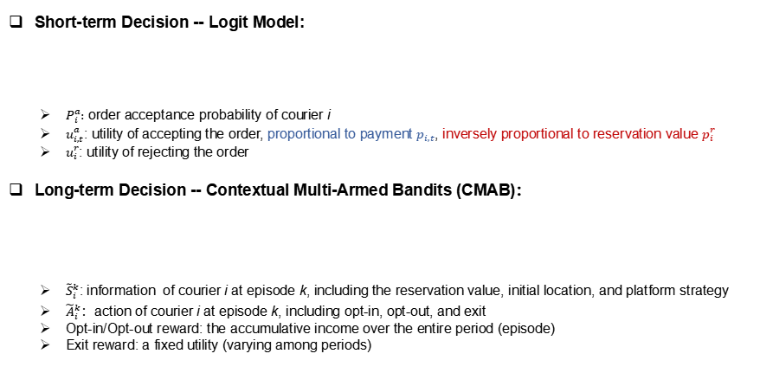
Model for Couriers: Logit Model & CMAB
Short-term Decision -- Logit Model:
$P_{i}^{a}:$ order acceptance probability of courier i
$u_{i,t}^{a}$: utility of accepting the order, proportional to payment $p_{i,t}$, inversely proportional to reservation value $p_{i}^{r}$
$u_{i}^{r}$: utility of rejecting the order
Long-term Decision -- Contextual Multi-Armed Bandits (CMAB)：
${\tilde{S}}_{i}^{k}$: information of courier i at episode k, including the reservation value, initial location, and platform strategy
${\tilde{A}}_{i}^{k}$：action of courier i at episode k, including opt-in, opt-out, and exit
Opt-in/Opt-out reward: the accumulative income over the entire period (episode)
Exit reward: a fixed utility (varying among periods)

Slide 10
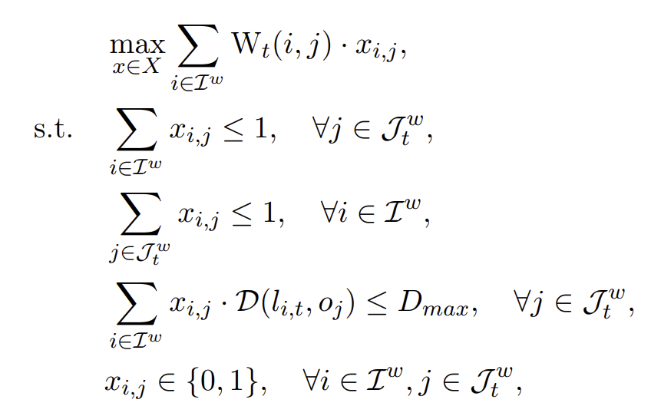
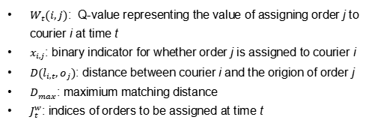
Solution Methodology for MDP of Platform
DDQN for Order Assignment:
Summary: A neural network is employed to estimate the long-term reward (Q-value) for each courier selecting each order at each time step.
Utilization: Find the optimal dispatching strategy to maximize the global Q-value (long-term reward) at each step through bipartite matching.
Training: gradient descent to minimize Temporal Difference (TD) error
$W_{t}(i,j)$: Q-value representing the value of assigning order j to courier i at time t
$x_{i,j}$: binary indicator for whether order j is assigned to courier i
$D(l_{i,t},o_{j})$: distance between courier i and the origion of order j
$D_{max}$: maximium matching distance
$J_{t}^{w}$: indices of orders to be assigned at time t

Slide 11
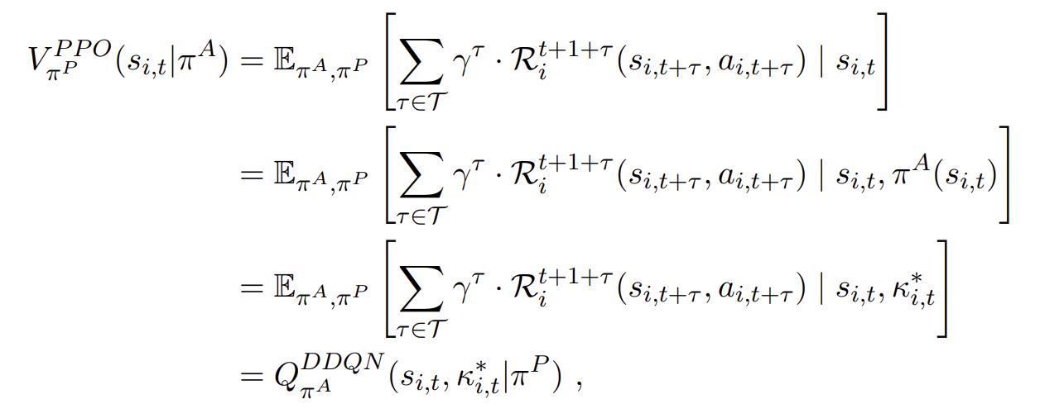
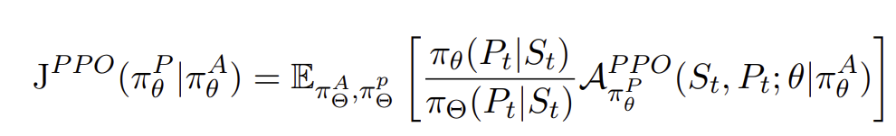
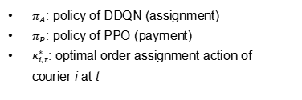
Solution Methodology for MDP of Platform
PPO for Payment Setting:
Summary: An actor network is employed to directly generate payments for each courier, while a critic network estimates the V-value to guide the updating of the critic network.
Finding: In our scenario, the PPO can directly utilize the Q-network of DDQN as the critic network.
Training of actor: policy gradient to maximize the objective function
$π_{A}$: policy of DDQN (assignment)
$π_{P}:$ policy of PPO (payment)
$κ_{i,t}^{∗}$: optimal order assignment action of courier i at t
Notes:
Since DDQN is an off-policy method but PPO is on-policy, we propsoe to train them alternatively to avoid any interference.

Slide 12
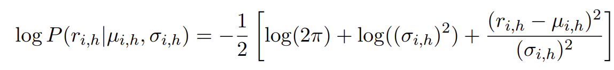
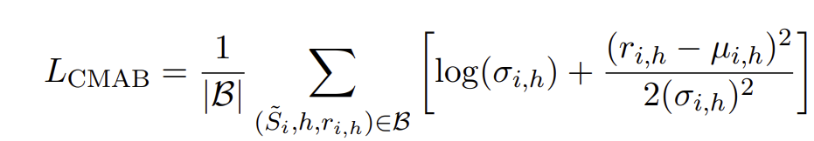
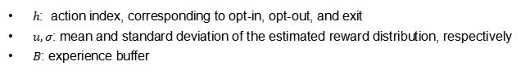
Solution Methodology for CMAB of Couriers
Thompson Sampling Method:
Summary: Utilize a neural network to estimate the reward distribution for each action within a given state.
Utilization: Select the action with the highest reward expectation.
Training: Model the reward distribution as a Gaussian distribution and train the network using Maximum Likelihood Estimation (MLE).
$h$: action index, corresponding to opt-in, opt-out, and exit
$u,σ$: mean and standard deviation of the estimated reward distribution, respectively
$B$: experience buffer

Slide 13
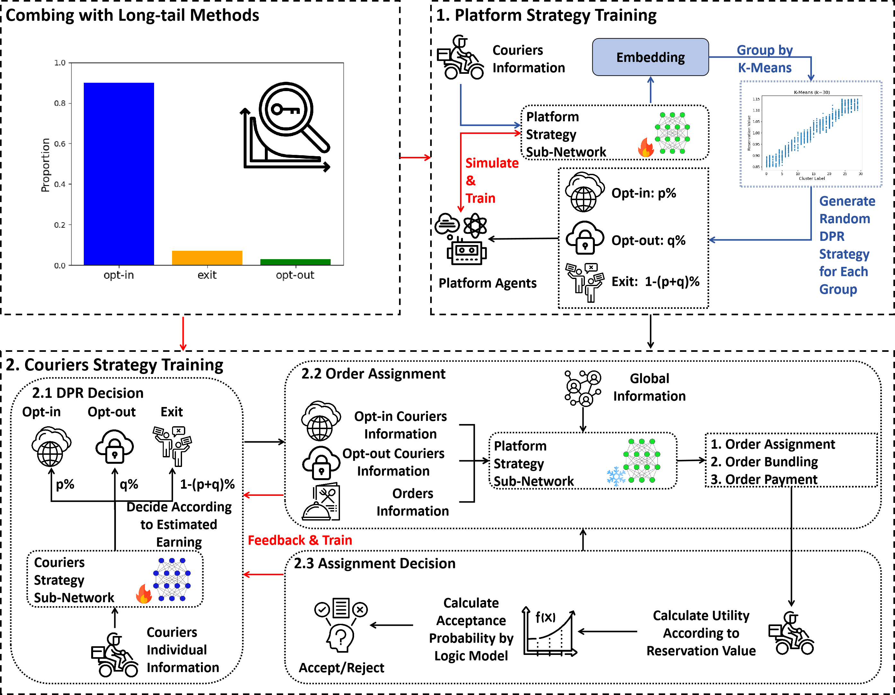
Training Process
Phase1: Platform Training
train an adaptive policy that optimally responds to all possible decisions made by couriers
Phase2: Couriers Training
given the fixed well-trained platform strategy, train couriers to identify the optimal long-term decisions aimed at maximizing cumulative earnings

Slide 14
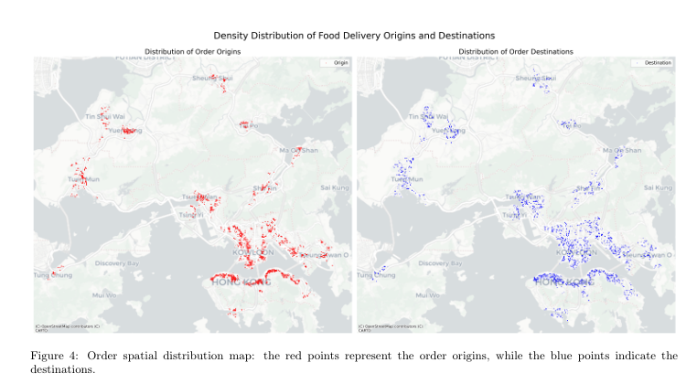
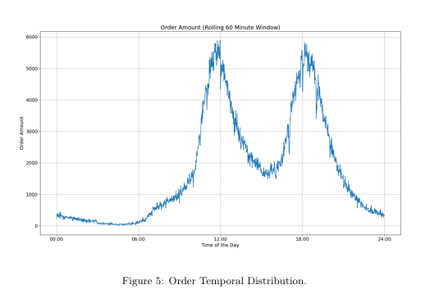
Case Studies
Food Delivery in Hong Kong, China

Slide 15
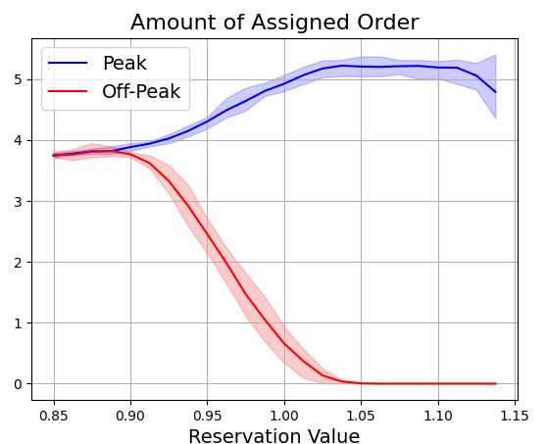
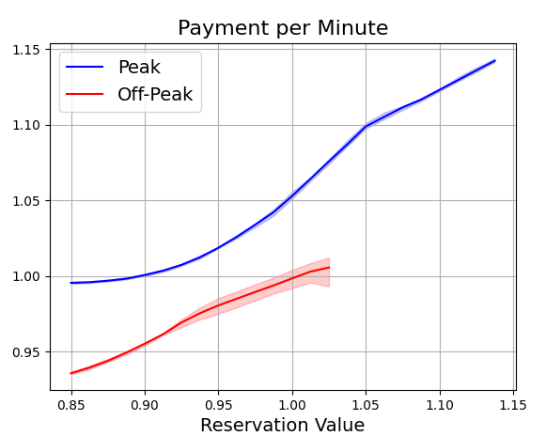
Case Studies
How platforms discriminate different types of couriers？
Higher reservation couriers receive:
higher unit payment (payment per time)
more orders in peak time
lower orders in off-peak time

Slide 16
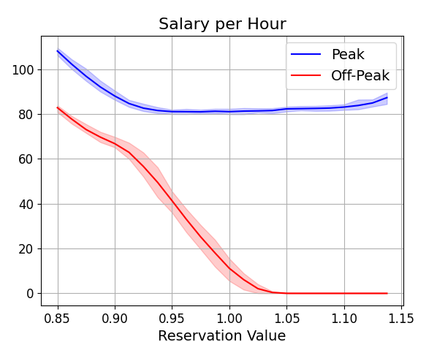
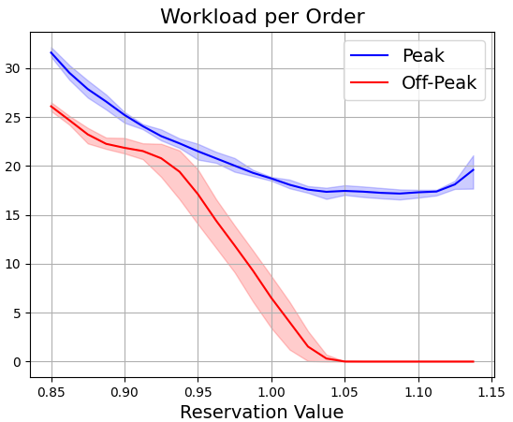
Case Studies
How platforms discriminate different types of couriers？
Higher reservation couriers receive:
orders with lower workload (value)
lower total earnings (salary per hour)

Slide 17
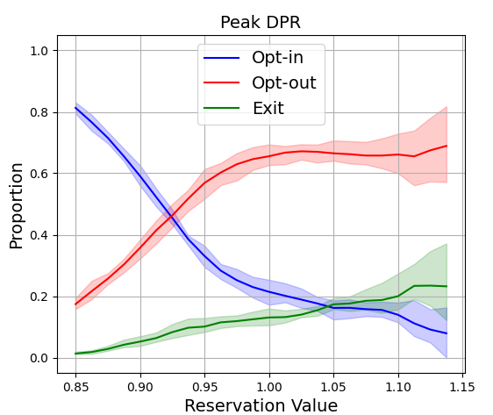
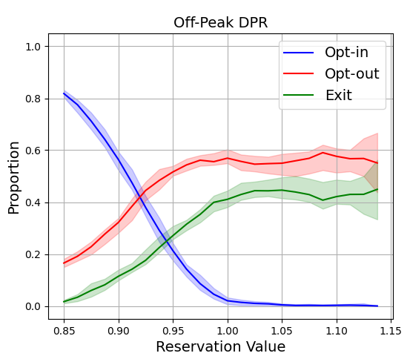
Case Studies
What’s the influence of DPR to couriers？
Higher reservation couriers have:
higher opt-out proportion
higher exit proportion
lower opt-in proportion

Slide 18
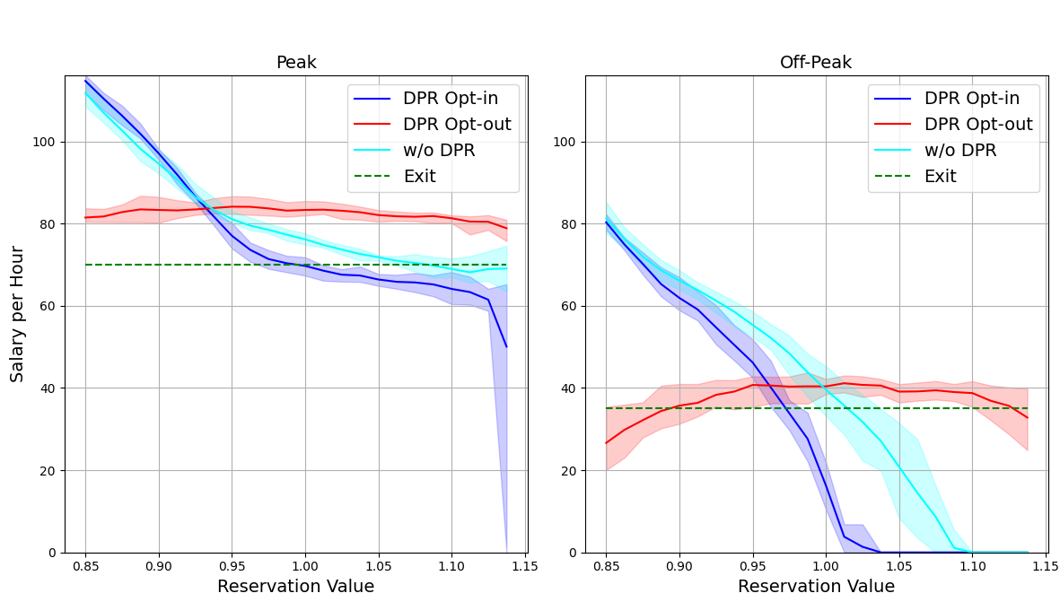
Case Studies
What’s the influence of DPR to couriers？
If couriers choose to opt in, those with higher reservation value have lower total earnings.
If couriers choose to opt out, different reservation value lead to similar total earnings.

Slide 19
Case Studies
What’s the influence of DPR to platform and customers？
The platform gets higher profits since the increased number of active couriers helps fulfill more orders.
Customers get better experience due to the increased number of active couriers, which allows the platform to optimize planning better, leading to a lower order delivery times.
 | Peak |  | Off-Peak
 | DPR | w/o DPR | DPR | w/o DPR
Profits | 12.31±0.77 | 11.17±0.71 | 4.57±0.28 | 4.42±0.25
Order Pickup | 3362.40±43.60 | 2679.40±120.40 | 1921.20±6.20 | 1882.9±26.80
Service Rate (%) | 57.18±0.74 | 45.57±2.05 | 98.02±0.32 | 96.06±1.37
Overtime Order | 192.40±15.40 | 172.60±16.60 | 100.00±17.00 | 117.80±5.80
Overtime Rate (%) | 5.72±0.53 | 6.45±0.73 | 5.21±0.89 | 6.26±0.32
Average Delivery Time | 20.70±0.22 | 21.17±0.57 | 19.24±0.29 | 20.64±0.40

Slide 20
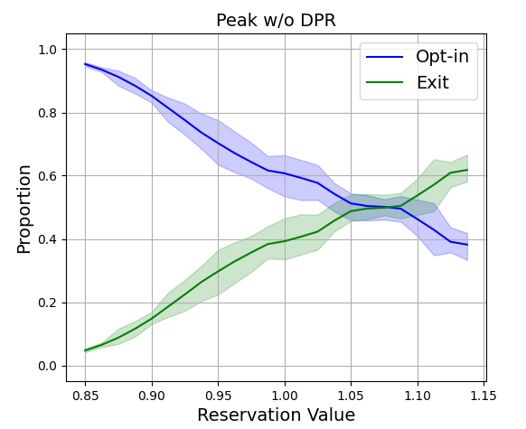
Case Studies
Comparison of courier choices w/ and w/o DPR:
On-Peak | DPR | w/o DPR
Exit Rate (%) | 9.36±1.16 | 27.16±3.14

Slide 21
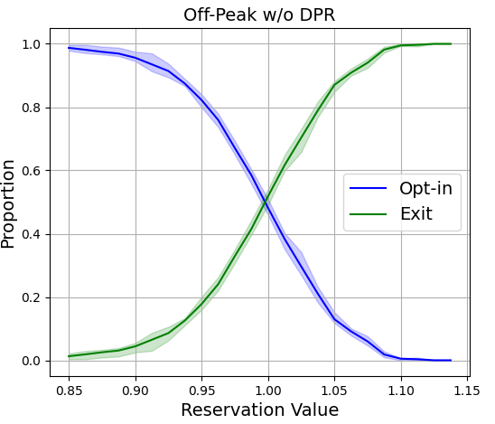
Case Studies
Comparison of courier choices w/ and w/o DPR:
Off-Peak | DPR | w/o DPR
Exit Rate (%) | 25.02±2.6 | 36.00±2.30

Slide 22
Thanks for your attention!
Presented by Zijian Zhao

Slide 23
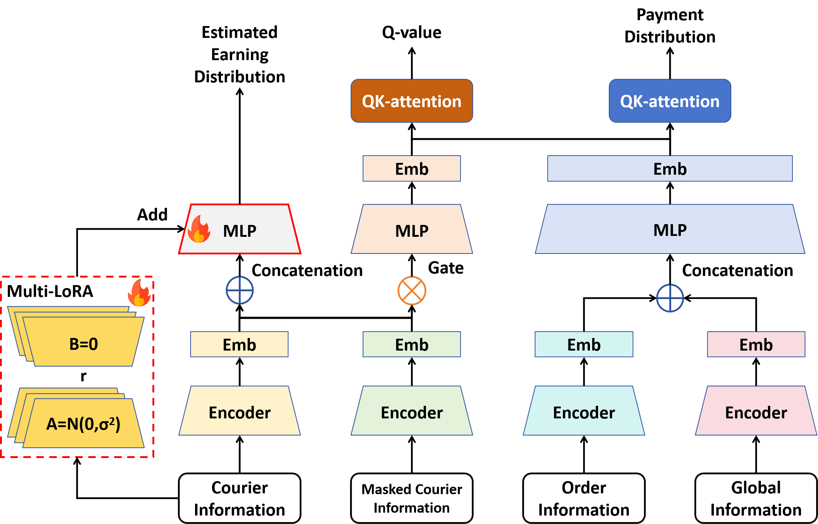
Neural Network Architecture
Shared Heterogeneous Encoder
shared structure enhances the extraction of robust features
heterogeneous structure facilitates simultaneous processing of opt-in and opt-out couriers.
Triple Decision Heads
for payment setting, order assignment, and courier long-term choice, respectively
Multi-LoRA for Couriers CMAB
shared encoder enables couriers to understand the platform's strategy
multiple lora prevents homogenous strategies among couriers, promoting diverse decision-making

Slide 24
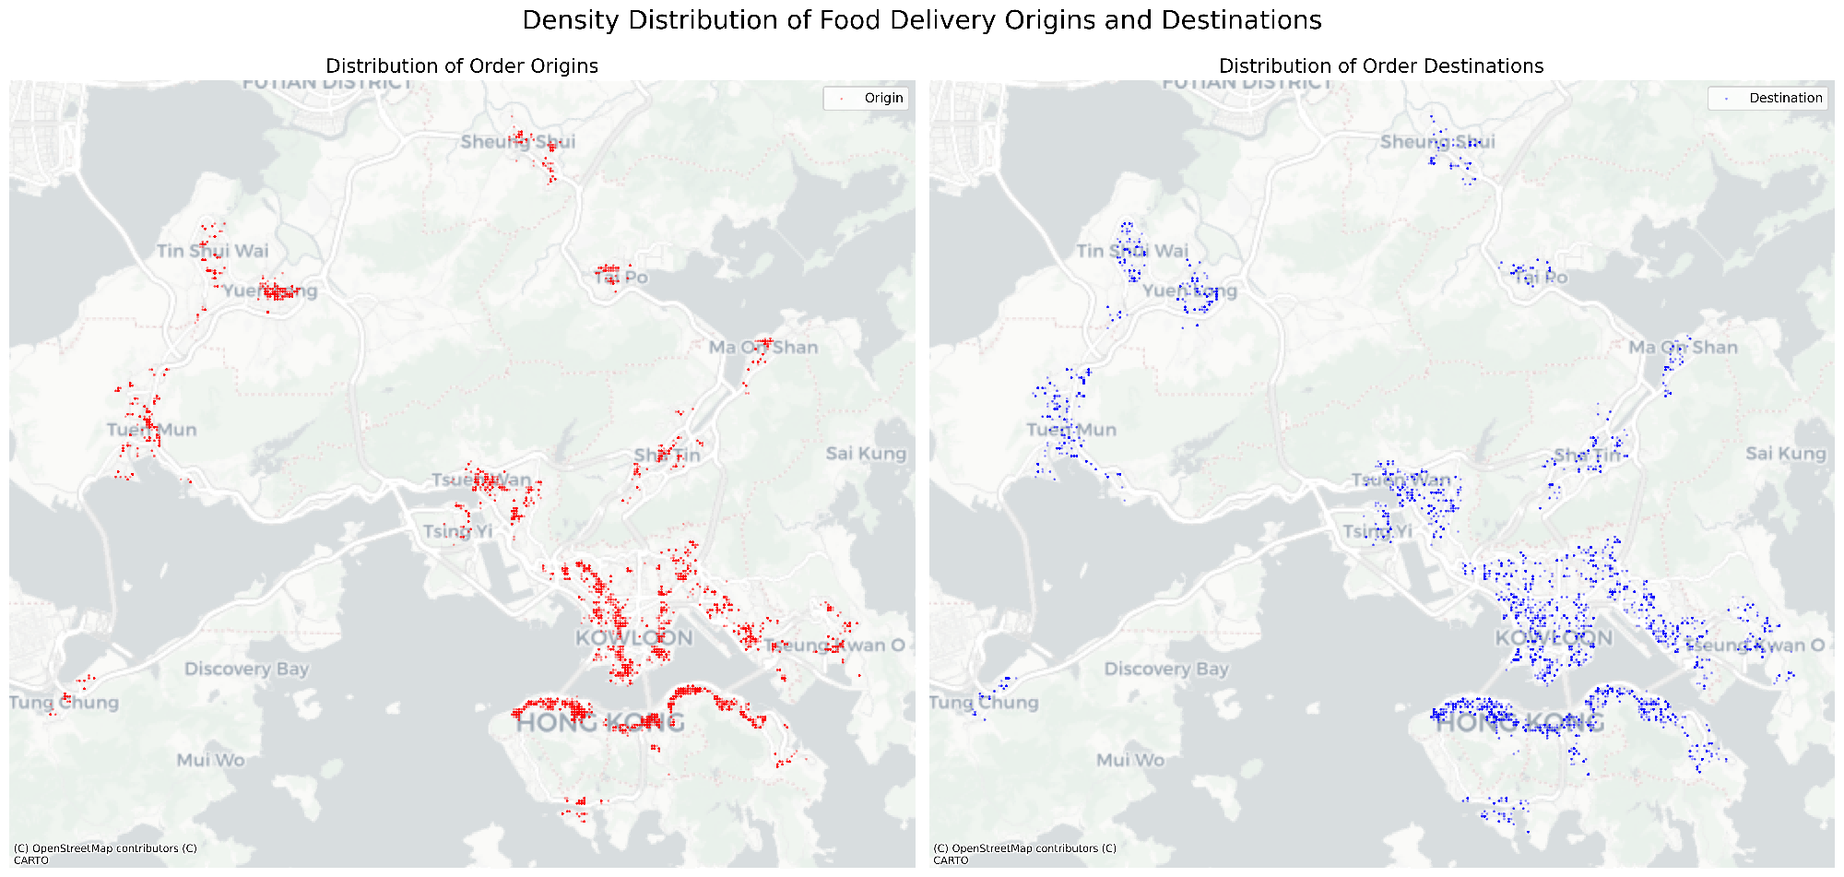
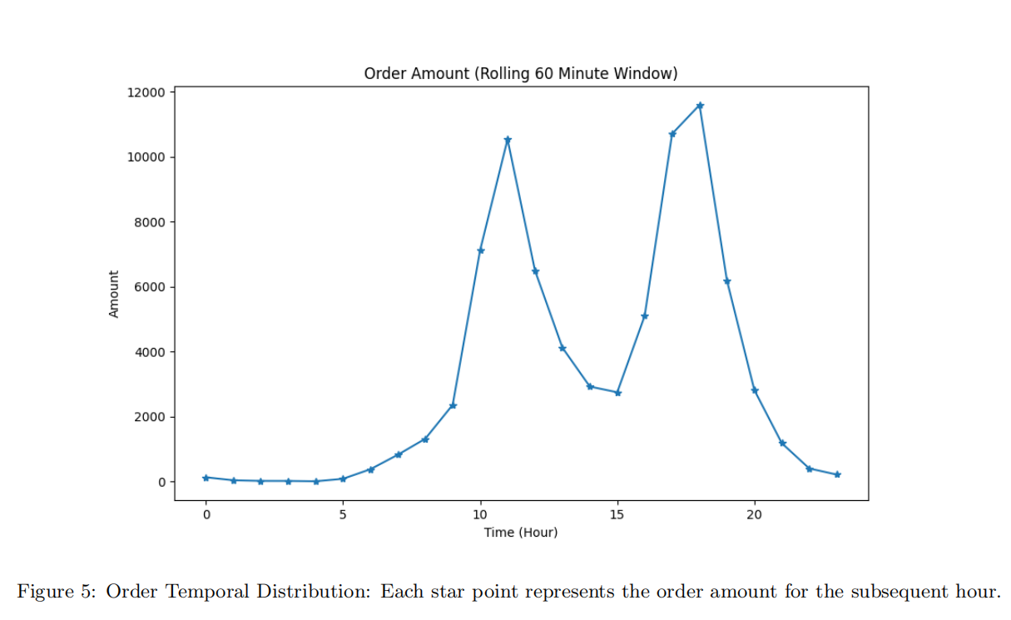
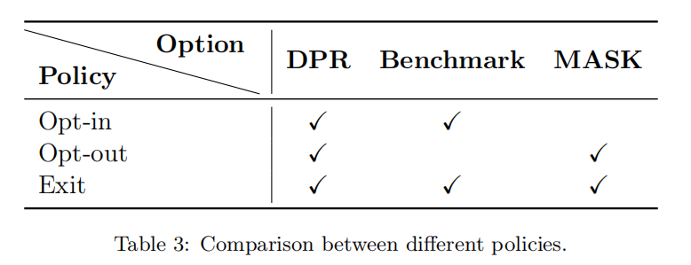
Case Studies
Food Delivery in Hong Kong, China
Comparative Policies

Slide 25
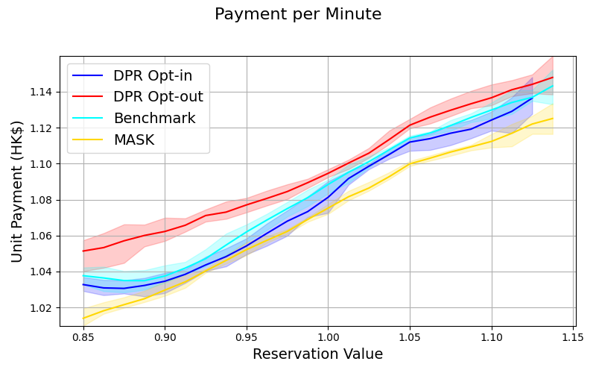
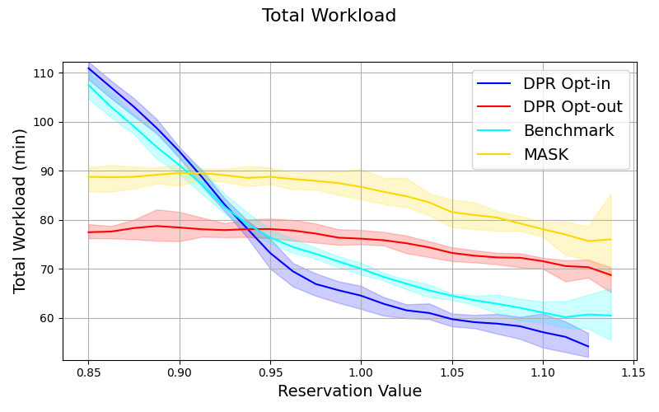
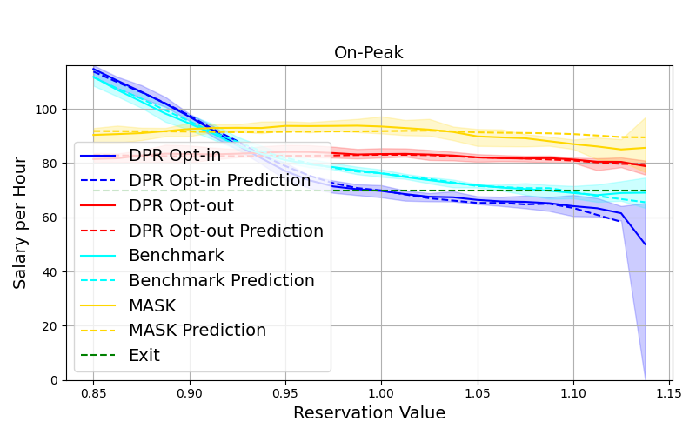
Case Studies
Unit Payment (payment per minute)
Total Workload (measured by time)
Total Earning (whole preiod)
How platforms discriminate different types of couriers？
For opt-in couriers (blue curves): Higher reservation couriers receive:
higher unit payments
lower workloads
lower total earnings
For opt-out couriers (red curves): Higher reservation couriers experience:
higher unit payments
slightly lower workloads
similar earnings compaerd to low reservation couriers

Slide 26
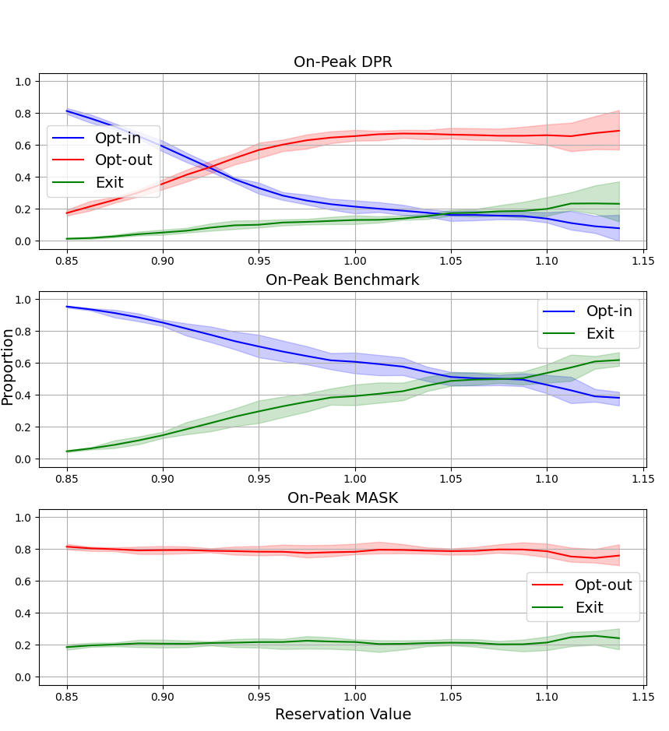
Case Studies
How DPR affects couriers behavior？
More couriers are attracted to choose opt-out option on the platform, leading to a lower exiting rate.
DPR effectively protects the rights of high-reservation couriers, allowing them to choose opt out to access more work opportunities.
Proportion of Choices Among Couriers

Slide 27
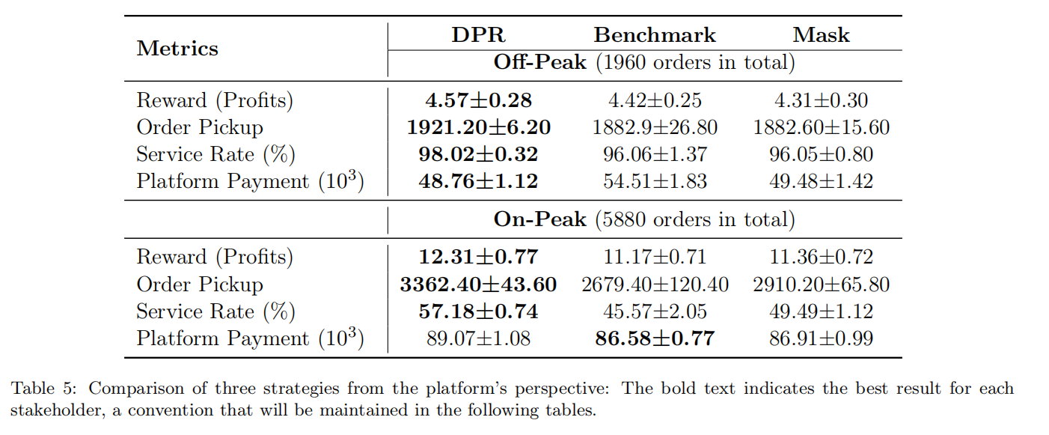
Case Studies
How DPR affects platform profits？
The platform gets higher profits since the increased number of active couriers helps fulfill more orders.

Slide 28
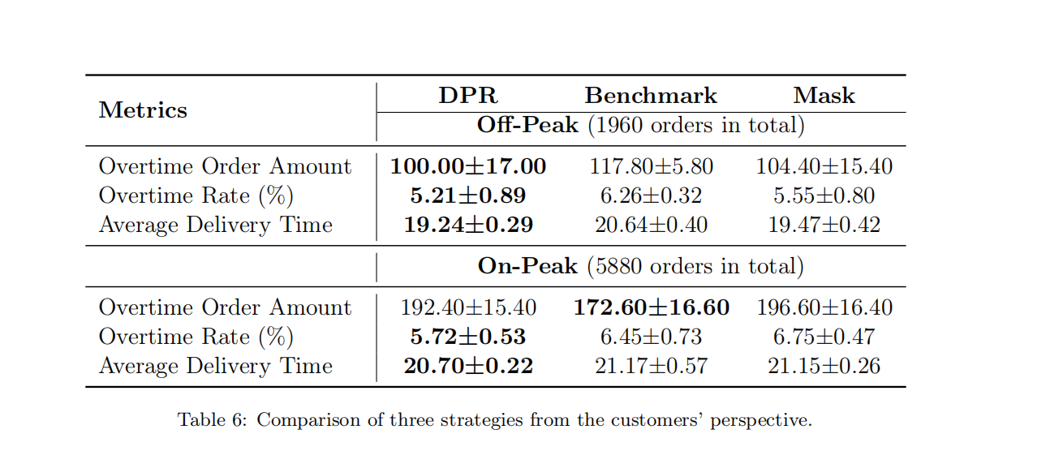
Case Studies
How DPR affects customers satisfication？
Customers get better experience due to the increased number of active couriers, which allows the platform to optimize planning better, leading to a lower order delivery times.

